Slide 1

Face mask and temperature detection
with Raspberry Pi
Tomer Vazana, Maks Moroshek, Daniel Marenko

Slide 2

It all starts with an idea
Covid-19 has changed the world, and computer engineering wasn't an exception.
The covid pandemic is still here and not everybody is taking the necessary safety precautions.
We propose a simple solution to lower the spread of the virus by checking that people are wearing their mask and also their temperature before they enter a crowded or enclosed place.

Slide 3
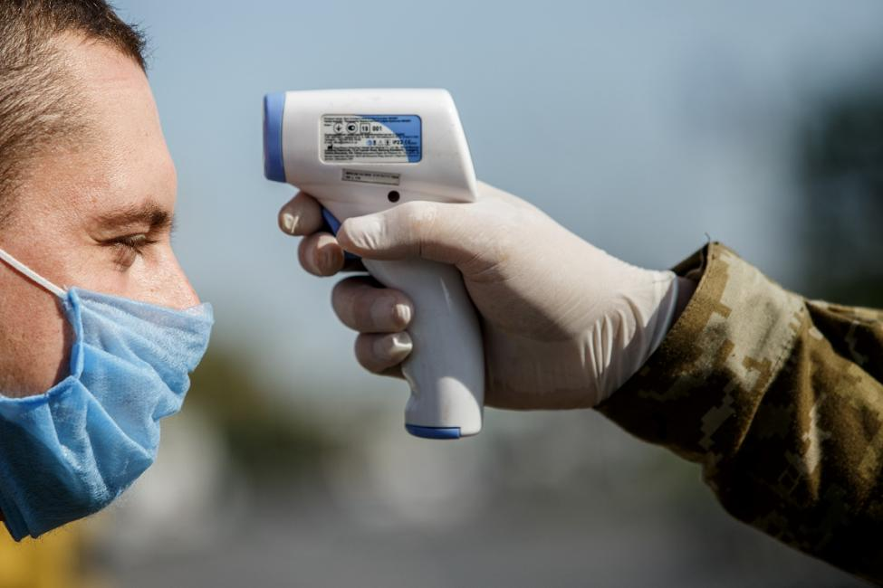
The manual way
Have someone check the temperature of every person using a temperature gun.

Slide 4
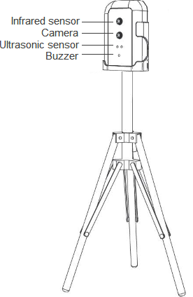
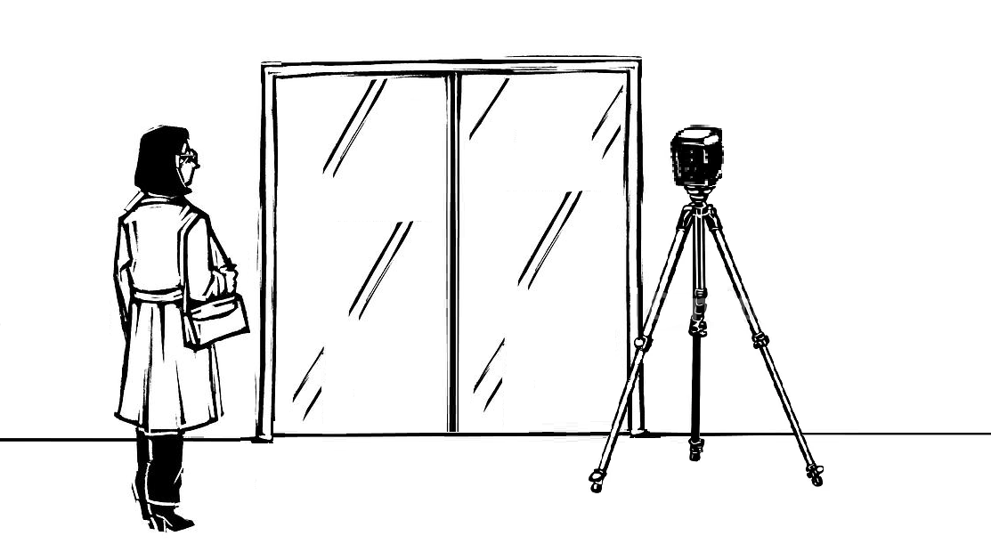
The automatic way
The automatic way: using a camera, sensors and machine learning.

Slide 5
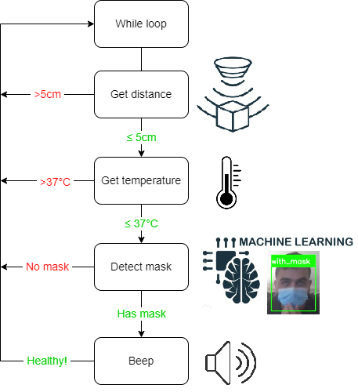

Slide 6
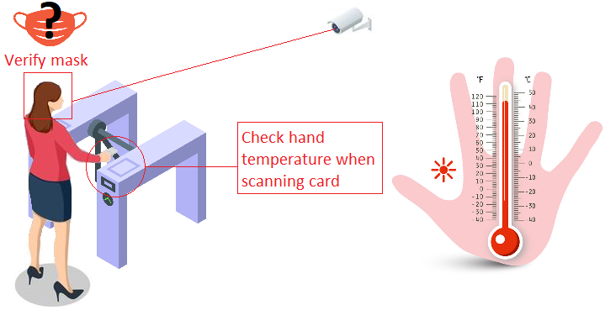

Slide 7
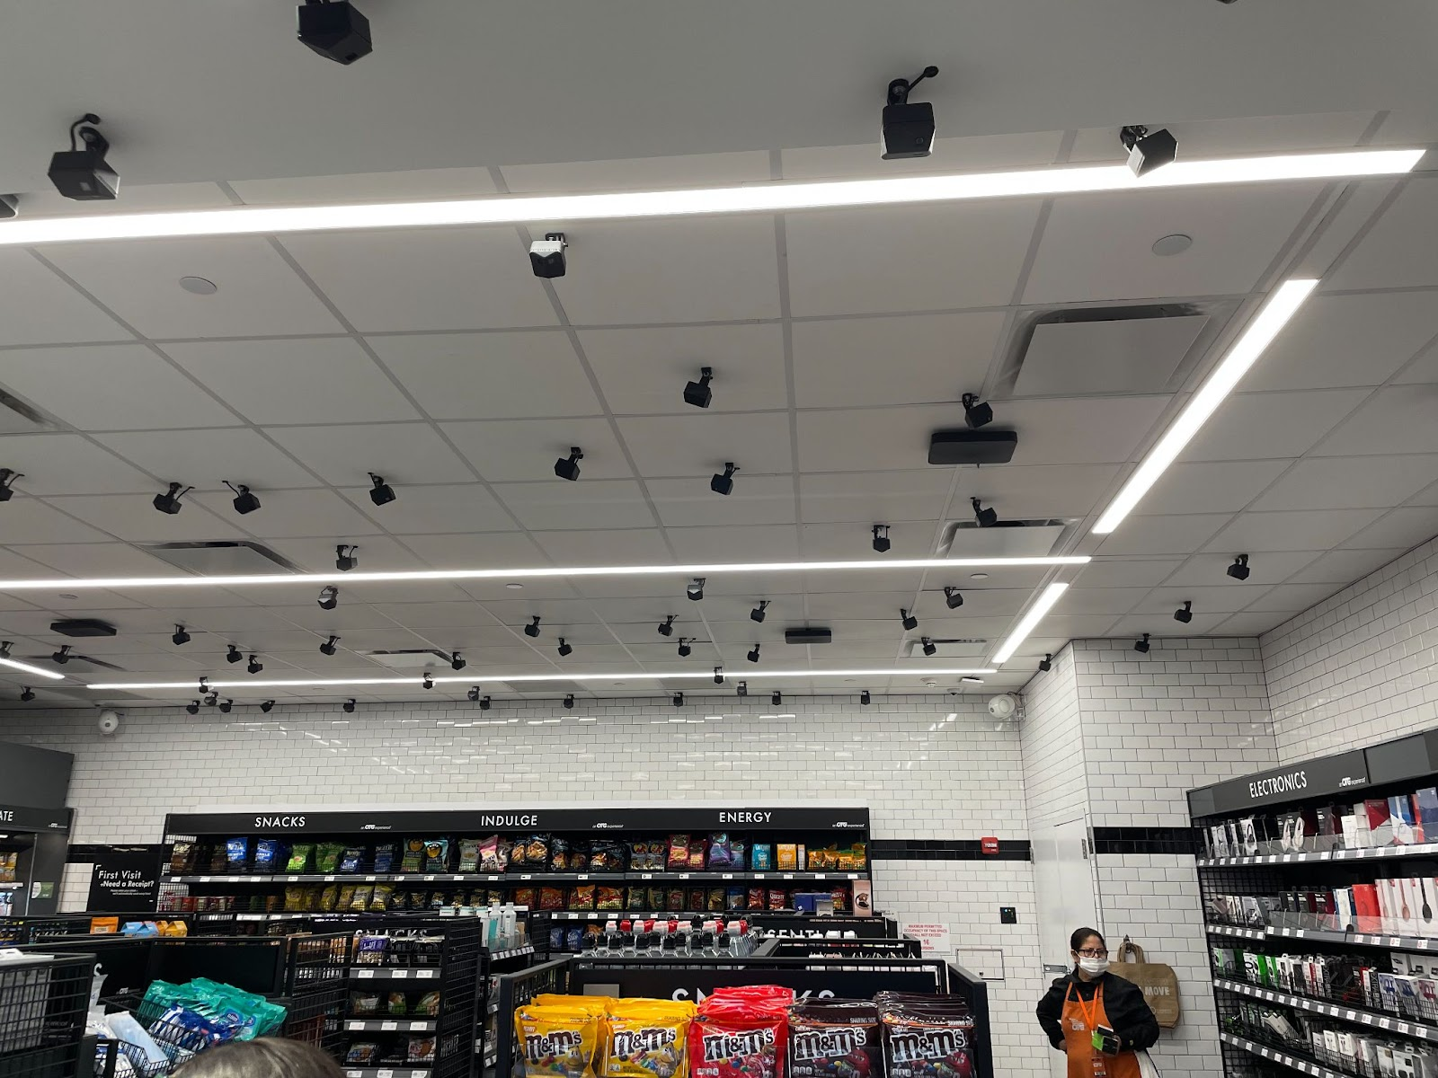
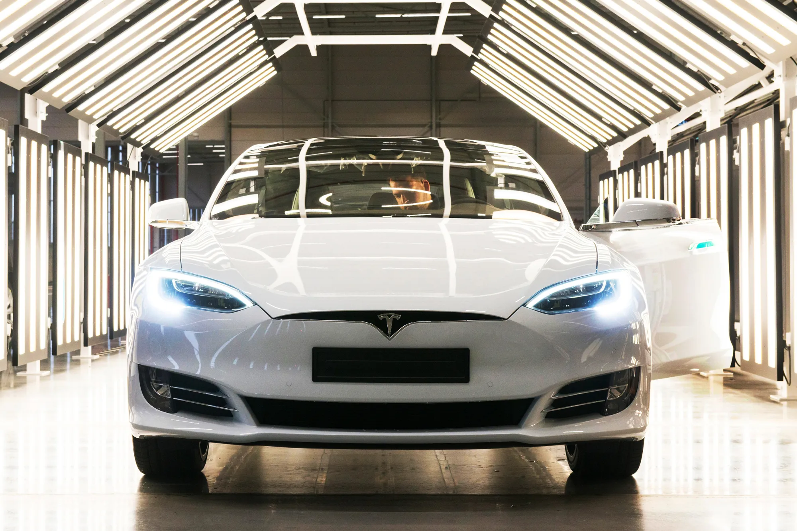
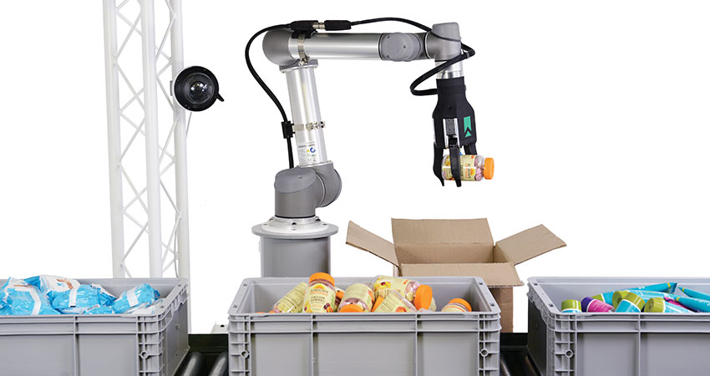
Automation is our future
Automation is transforming businesses and will contribute to economic growth via contributions to productivity.
Examples of automation: smart stores (Amazon Go, Trigo), autonomous driving (Tesla), warehouse automation.

Slide 8
Manual vs automatic
Manual:
Pros:
More difficult to bypass a guard
Very simple solution
Cons:
Expensive (have to hire an employee)
Can be slower (machines are generally more efficient)
Less scalable than machines (managing people is harder than machines)
Automatic:
Pros:
Cheap
Scalable (can easily setup multiple machines)
Cons:
Might be tricked or fooled
No human to talk to if there’s a problem

Slide 9
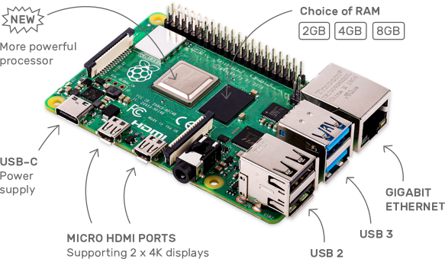
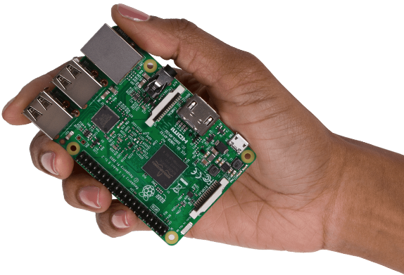
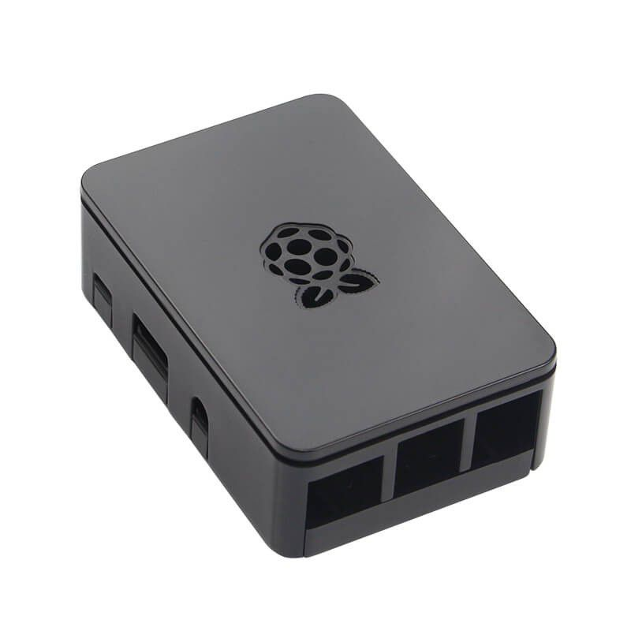
What is Raspberry Pi?
The Raspberry Pi is a low cost, tiny computer used for hardware projects and rapid prototyping.
It is widely used in electrical engineering and robotics.

Slide 10
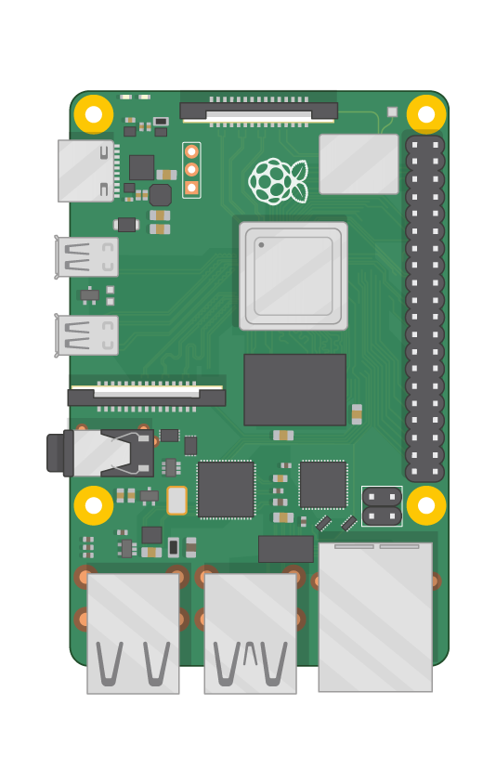
Specifications
Broadcom BCM2711, Quad core Cortex-A72 (ARM v8) 64-bit SoC @ 1.5GHz
2GB, 4GB or 8GB LPDDR4-3200 SDRAM (depending on model)
2.4 GHz and 5.0 GHz IEEE 802.11ac wireless, Bluetooth 5.0, BLE
Gigabit Ethernet
2 USB 3.0 ports; 2 USB 2.0 ports.
Raspberry Pi standard 40 pin GPIO header (fully backwards compatible with previous boards)
2 × micro-HDMI ports (up to 4kp60 supported)
2-lane MIPI DSI display port
2-lane MIPI CSI camera port
4-pole stereo audio and composite video port
H.265 (4kp60 decode), H264 (1080p60 decode, 1080p30 encode)
OpenGL ES 3.1, Vulkan 1.0
Micro-SD card slot for loading operating system and data storage
5V DC via USB-C connector (minimum 3A*)
5V DC via GPIO header (minimum 3A*)
Power over Ethernet (PoE) enabled (requires separate PoE HAT)
Operating temperature: 0 – 50 degrees C ambient

Slide 11
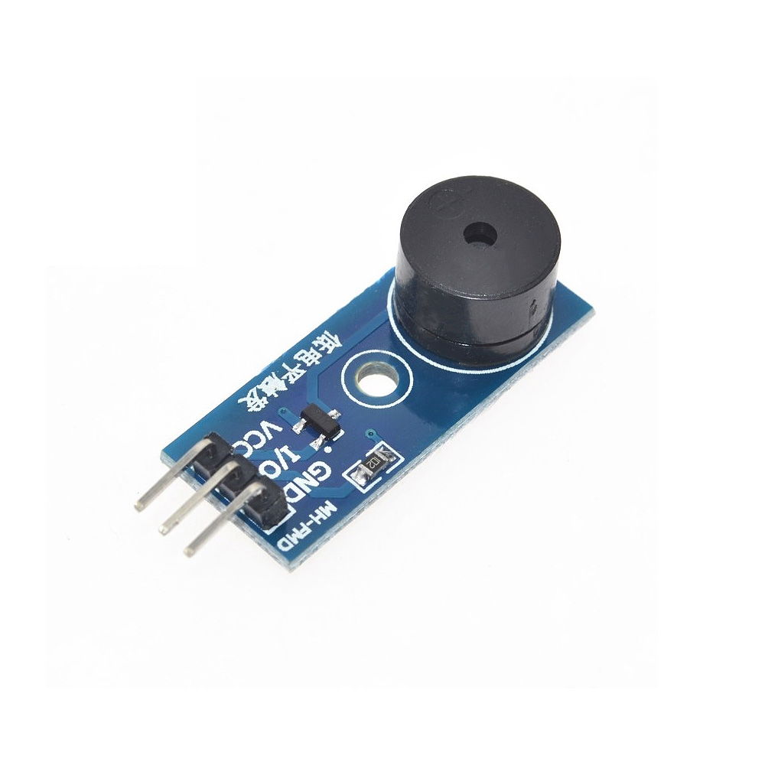
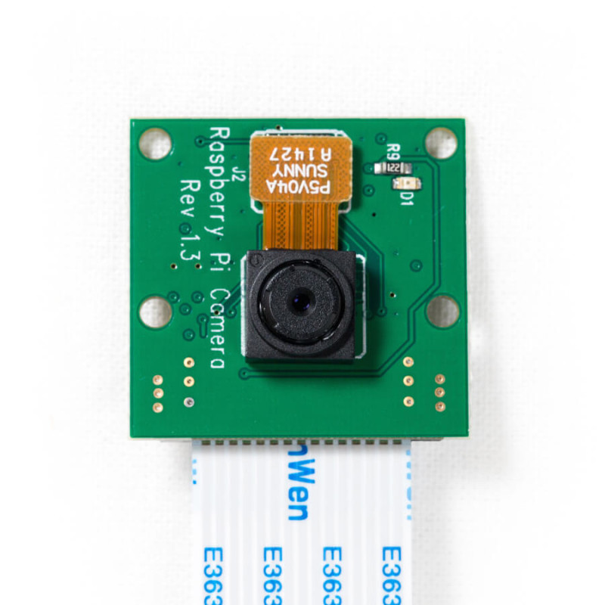
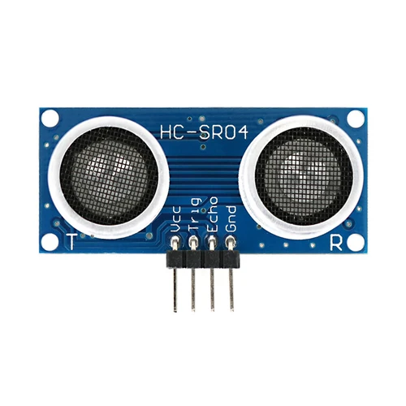
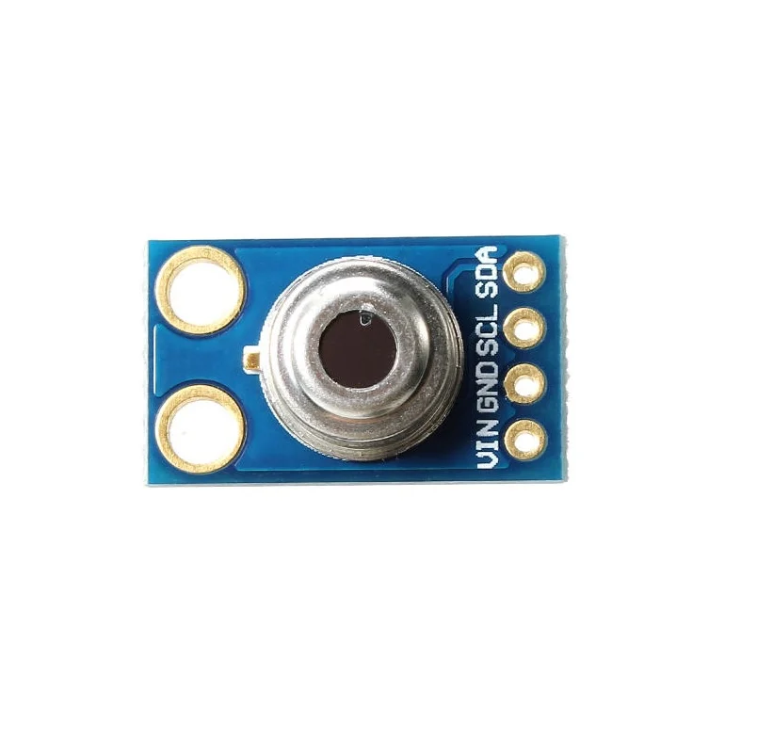
Multitude of sensors
Raspberry Pi’s wide range of available sensors allows us to interact with the physical world from our code.
Sensors used in the project:
Ultrasonic proximity sensor
Infrared sensor
Buzzer module
Pi Camera

Slide 12
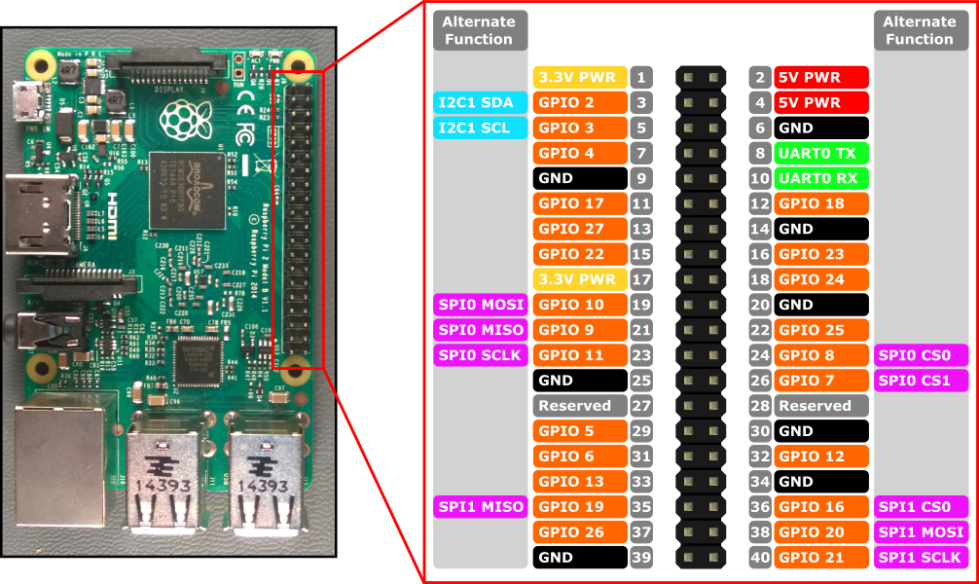
GPIO Pinout
RPi header has 40 pins.
There are pins for voltage, ground, general purpose (I/O) and a few specialized pins.
This is the interface to connect our sensors.

Slide 13
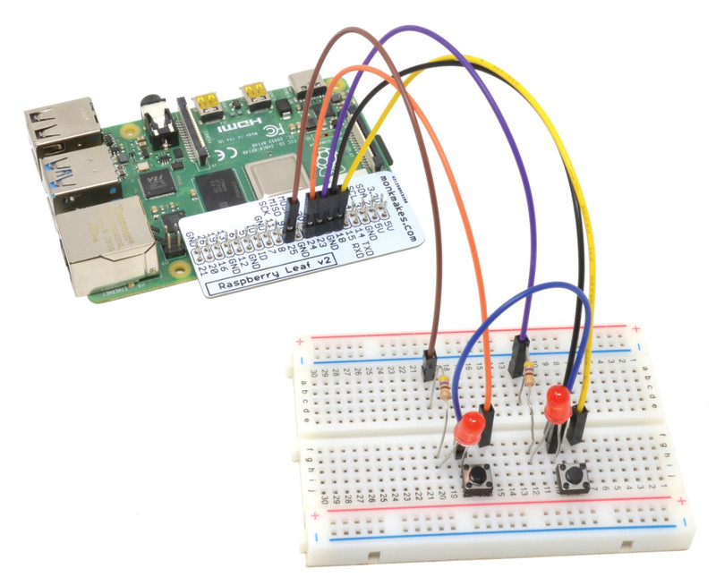
Breadboard and jump wires
Using a breadboard and jump wires,
we can create our circuit of sensors without soldering.
This is an essential step of prototyping to understand how you want to design your circuit.

Slide 14
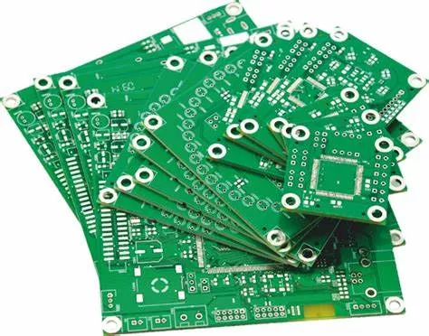
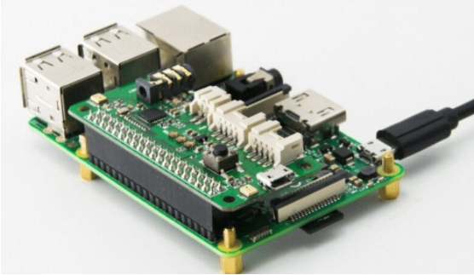
Printed Circuit Board (PCB)
When the design is finalized, PCB (Printed Circuit Board) can be custom ordered to replace the breadboard and jump wires.
Various online websites offer this service for an affordable price.

Slide 15
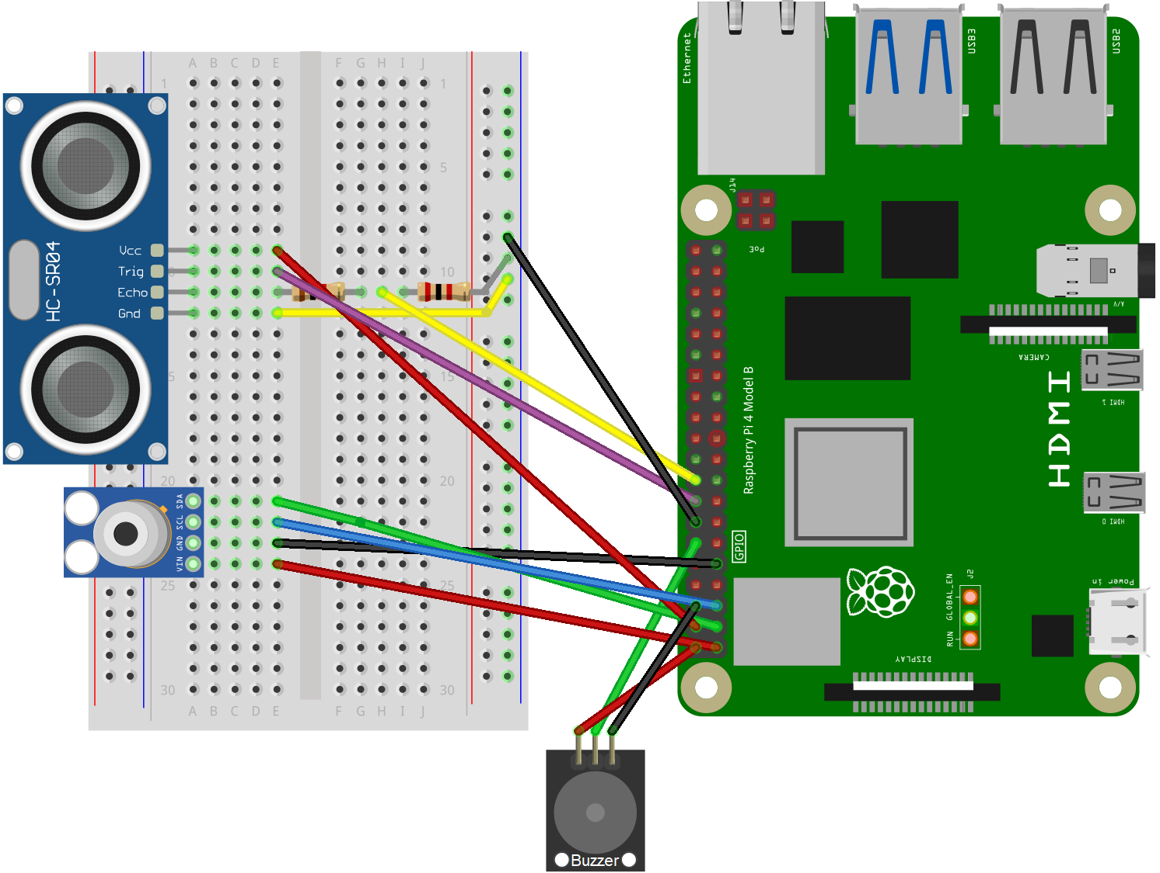
The circuit
Every sensor
has a datasheet
provided by the manufacturer
which specifies how to connect the sensor.
Designed with the open-source software Fritzing.

Slide 16
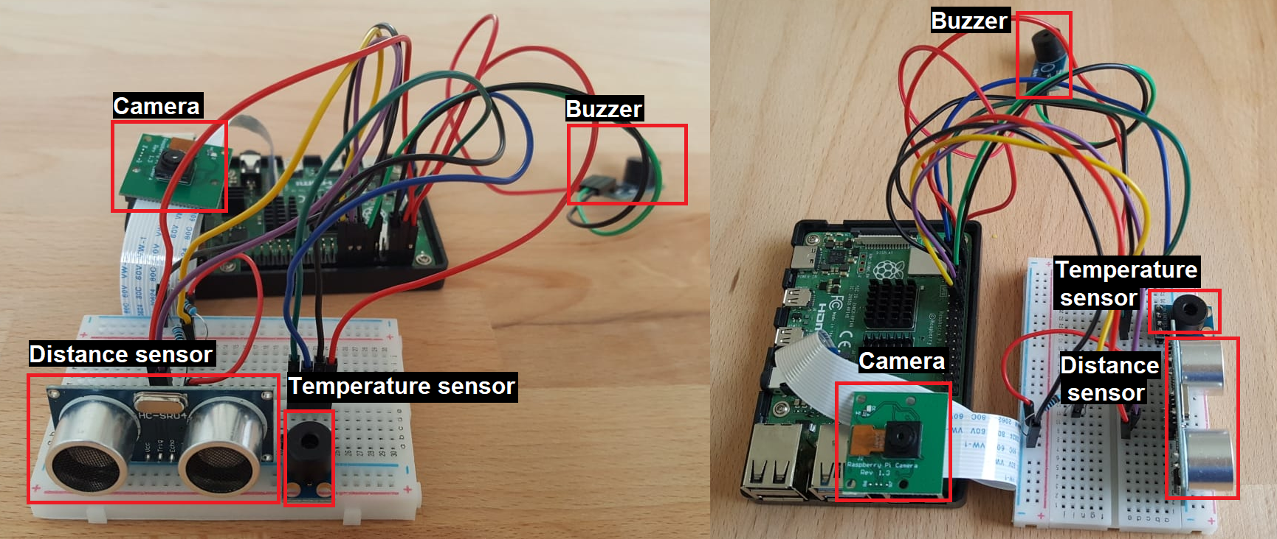
In practice

Slide 17
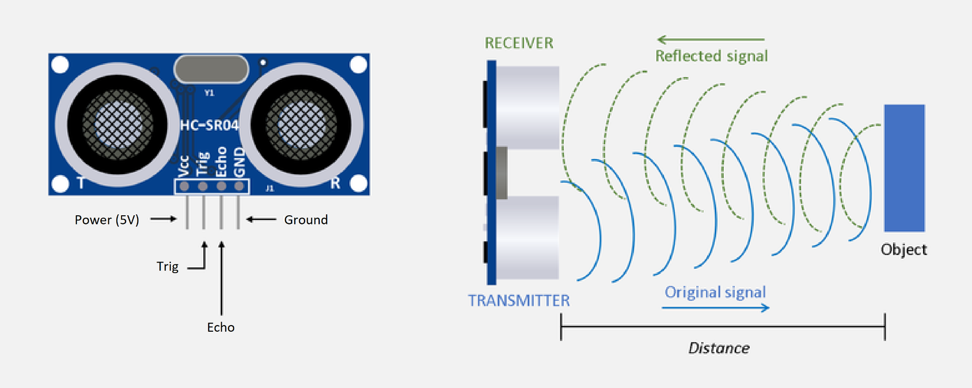
Ultrasonic proximity sensor

Slide 18
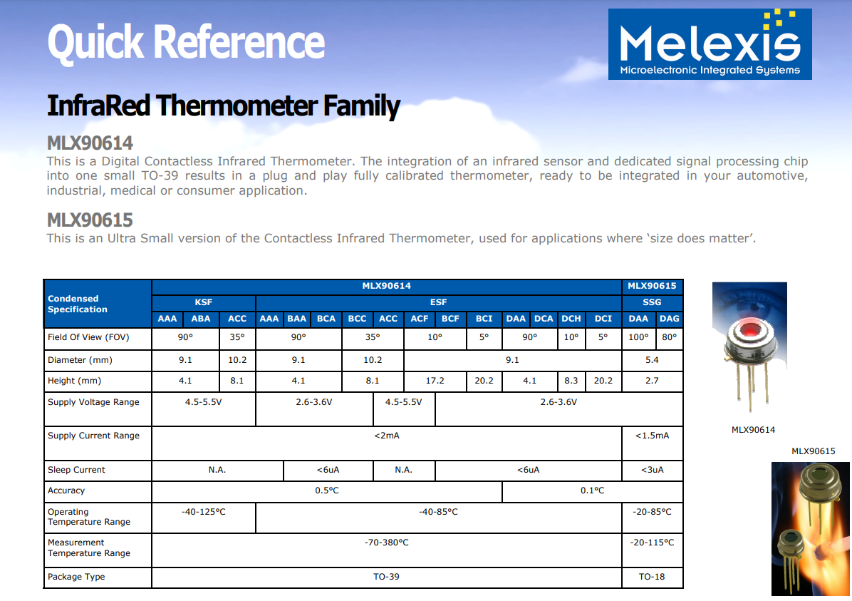
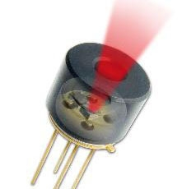
Smaller field of view = better accuracy

Slide 19
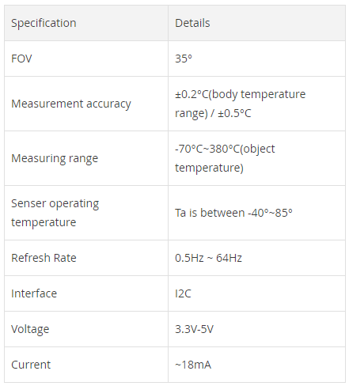
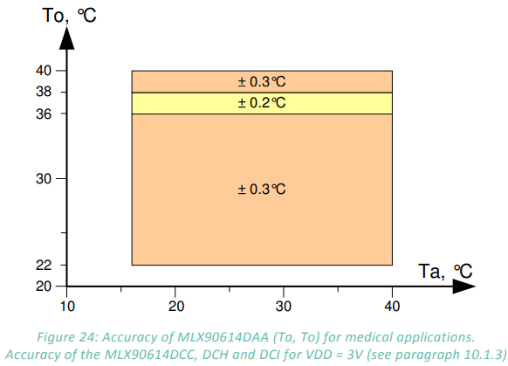
Medical accuracy
To - Object temperature:
The average temperature within the optical cone of the sensor.
Ta - Ambient temperature:
Air temperature surrounding the sensor itself. This value is used by the manufacturer to calculate To.
DCC model:
35° field of view

Slide 20
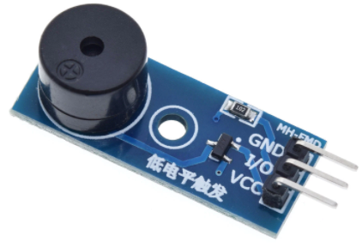
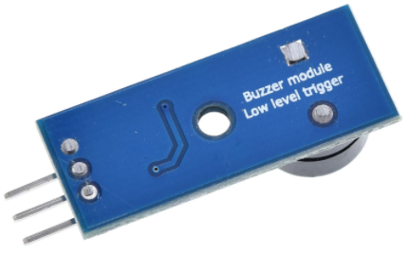
Buzzer

Slide 21
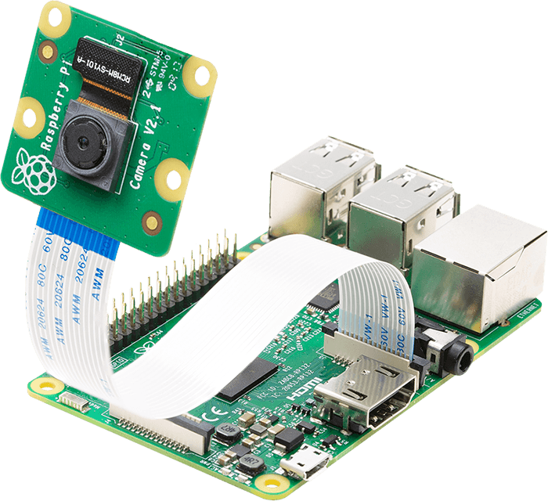
PiCamera

Slide 22
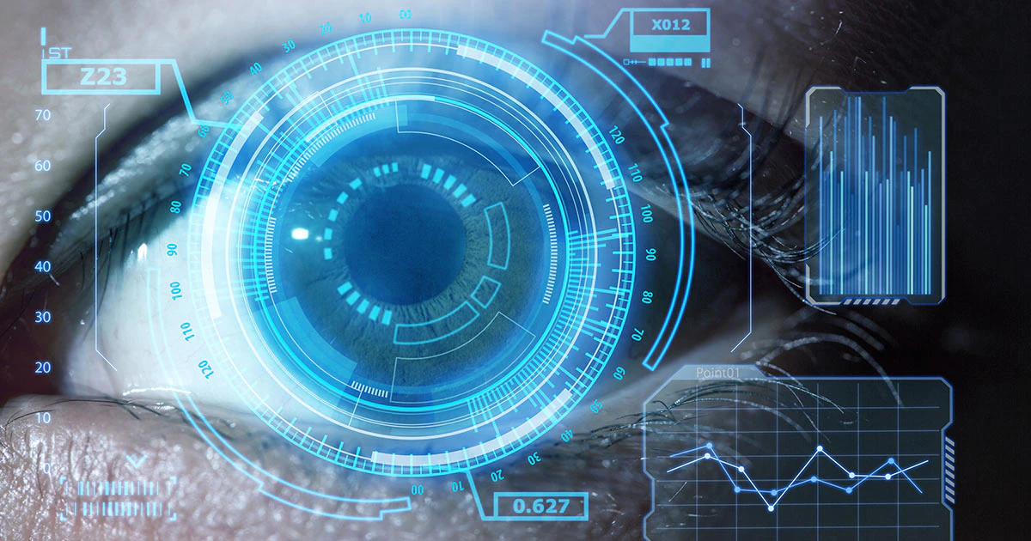

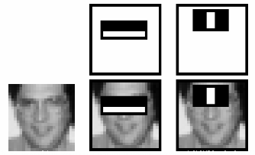

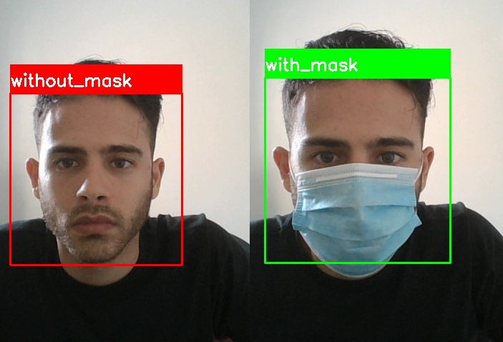
Computer vision
=
+
Viola-Jones algorithm

Slide 23
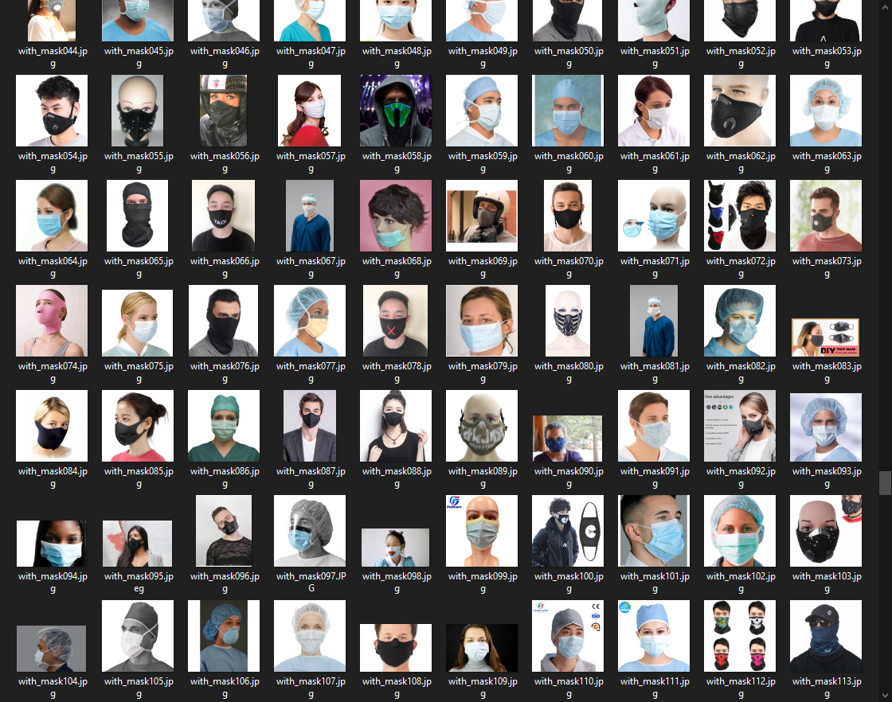
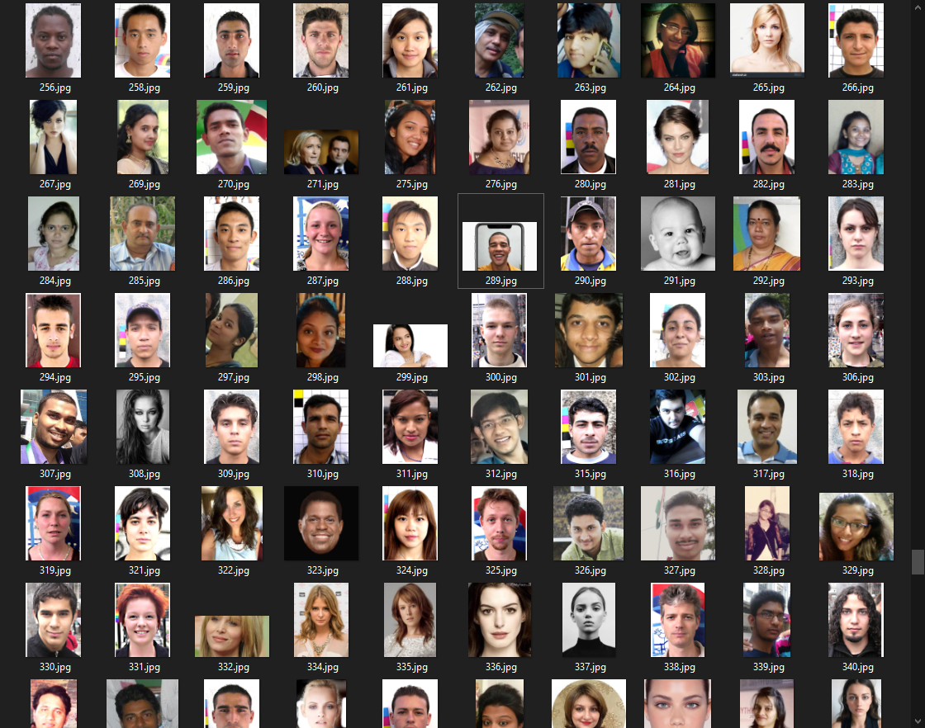
Dataset
6500 photos, 30 epochs

Slide 24
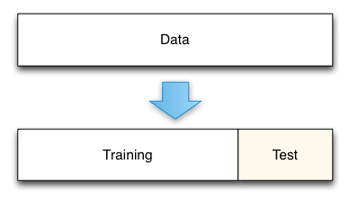
Split dataset

Slide 25
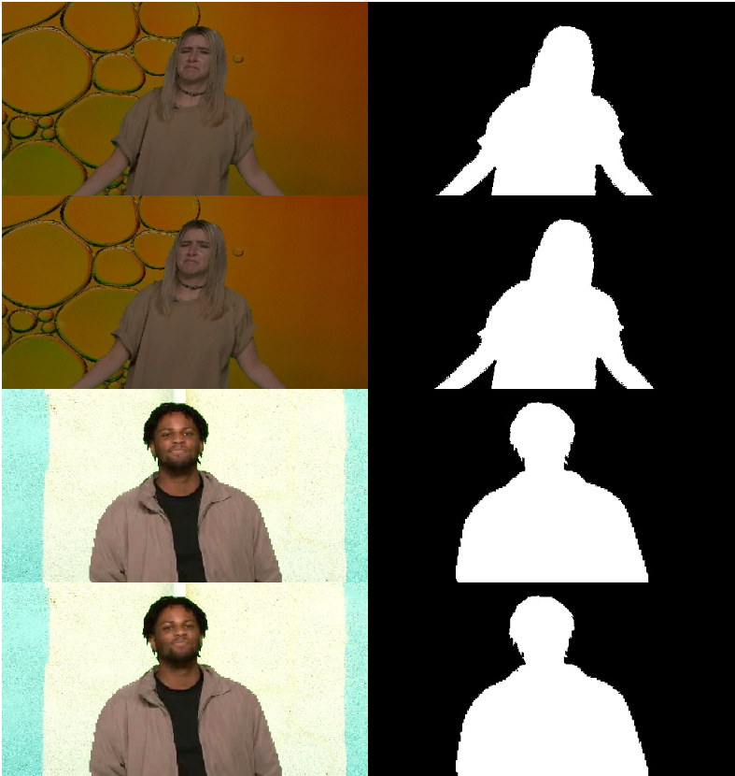
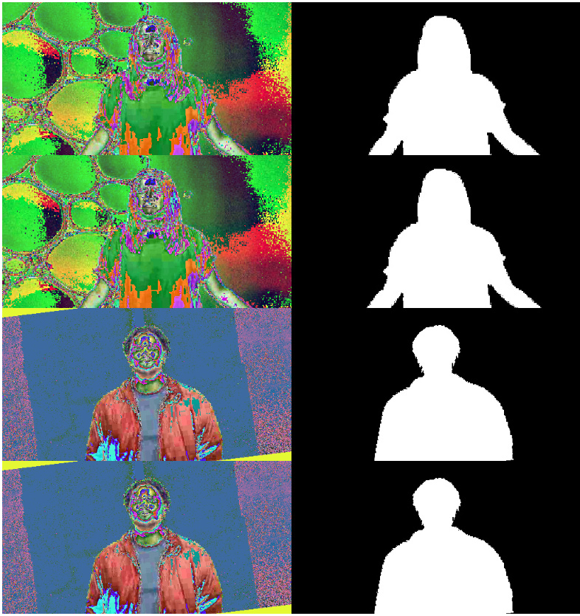
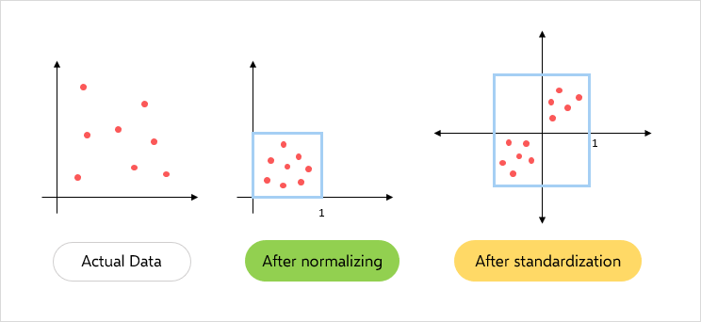
Image data normalization
Before normalization
After normalization

Slide 26
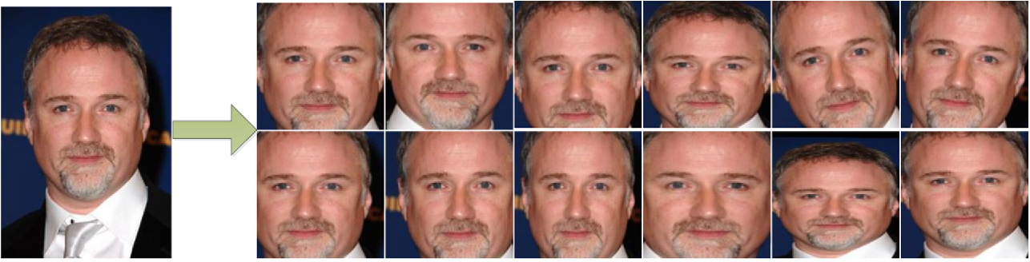
Image augmentation
Rescale, rotate, shift, shear, zoom, flip

Slide 27
Model #1
Layer (type) Output Shape Param #
=================================================================
conv2d (Conv2D) (None, 222, 222, 100) 2800
_________________________________________________________________
conv2d_1 (Conv2D) (None, 220, 220, 100) 90100
_________________________________________________________________
flatten (Flatten) (None, 4840000) 0
_________________________________________________________________
dense (Dense) (None, 50) 242000050
_________________________________________________________________
dense_1 (Dense) (None, 2) 102
=================================================================
Total params: 242,093,052
Trainable params: 242,093,052
Non-trainable params: 0
optimizer='adam', loss='binary_crossentropy', metrics=['acc']

Slide 28
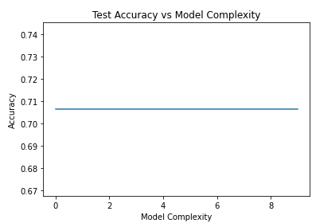
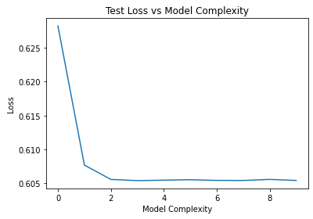
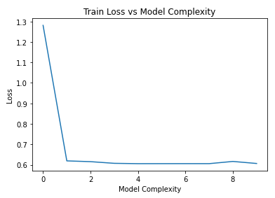
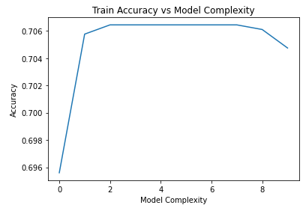
Model #1
Test accuracy: 69.9%, Test loss: 38.1%

Slide 29
Model #2
Layer (type) Output Shape Param #
=================================================================
conv2d_2 (Conv2D) (None, 222, 222, 100) 2800
_________________________________________________________________
max_pooling2d (MaxPooling2D) (None, 111, 111, 100) 0
_________________________________________________________________
conv2d_3 (Conv2D) (None, 109, 109, 100) 90100
_________________________________________________________________
max_pooling2d_1 (MaxPooling2 (None, 54, 54, 100) 0
_________________________________________________________________
flatten_1 (Flatten) (None, 291600) 0
_________________________________________________________________
dropout (Dropout) (None, 291600) 0
_________________________________________________________________
dense_2 (Dense) (None, 50) 14580050
_________________________________________________________________
dense_3 (Dense) (None, 2) 102
=================================================================
Total params: 14,673,052
Trainable params: 14,673,052
Non-trainable params: 0
optimizer='adam', loss='binary_crossentropy', metrics=['acc']

Slide 30
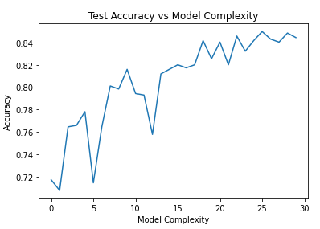
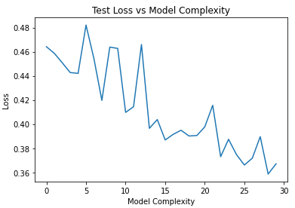
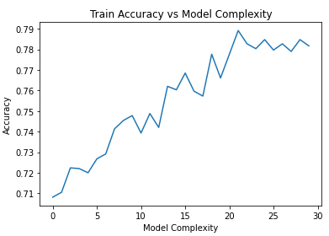
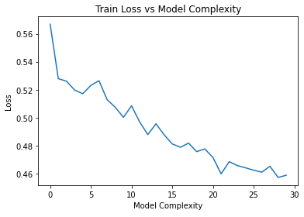
Model #2
Test accuracy: 80%, Test loss: 40%

Slide 31
Model #3
Layer (type) Output Shape Param #
=================================================================
conv2d_4 (Conv2D) (None, 222, 222, 100) 2800
_________________________________________________________________
max_pooling2d_2 (MaxPooling2 (None, 111, 111, 100) 0
_________________________________________________________________
batch_normalization (BatchNo (None, 111, 111, 100) 400
_________________________________________________________________
conv2d_5 (Conv2D) (None, 109, 109, 100) 90100
_________________________________________________________________
max_pooling2d_3 (MaxPooling2 (None, 54, 54, 100) 0
_________________________________________________________________
batch_normalization_1 (Batch (None, 54, 54, 100) 400
_________________________________________________________________
flatten_2 (Flatten) (None, 291600) 0
_________________________________________________________________
dropout_1 (Dropout) (None, 291600) 0
_________________________________________________________________
dense_4 (Dense) (None, 50) 14580050
_________________________________________________________________
batch_normalization_2 (Batch (None, 50) 200
_________________________________________________________________
dense_5 (Dense) (None, 2) 102
=================================================================
Total params: 14,674,052
Trainable params: 14,673,552
Non-trainable params: 500
optimizer='adam', loss='binary_crossentropy', metrics=['acc']

Slide 32
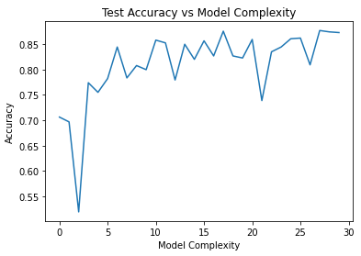
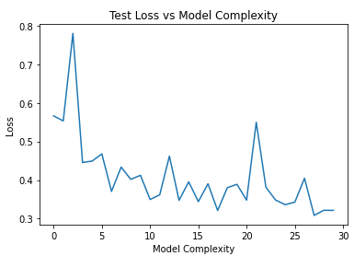


Model #3
Test accuracy: 32.1%, Test loss: 87.7%

Slide 33
Model #4
Layer (type) Output Shape Param #
=================================================================
conv2d_6 (Conv2D) (None, 222, 222, 100) 2800
_________________________________________________________________
max_pooling2d_4 (MaxPooling2 (None, 111, 111, 100) 0
_________________________________________________________________
batch_normalization_3 (Batch (None, 111, 111, 100) 400
_________________________________________________________________
conv2d_7 (Conv2D) (None, 109, 109, 100) 90100
_________________________________________________________________
max_pooling2d_5 (MaxPooling2 (None, 54, 54, 100) 0
_________________________________________________________________
batch_normalization_4 (Batch (None, 54, 54, 100) 400
_________________________________________________________________
flatten_3 (Flatten) (None, 291600) 0
_________________________________________________________________
dropout_2 (Dropout) (None, 291600) 0
_________________________________________________________________
dense_6 (Dense) (None, 50) 14580050
_________________________________________________________________
batch_normalization_5 (Batch (None, 50) 200
_________________________________________________________________
dense_7 (Dense) (None, 2) 102
=================================================================
Total params: 14,674,052
Trainable params: 14,673,552
Non-trainable params: 500
optimizer=SGD(learning_rate=ExponentialDecay(initial_learning_rate=1e-2, decay_steps=10000, decay_rate=0.9), loss='binary_crossentropy', metrics=['acc'])

Slide 34




Model #4
Test accuracy: 89.9%, Test loss: 27.3%

Slide 35
Model #5
Layer (type) Output Shape Param #
=================================================================
conv2d_10 (Conv2D) (None, 222, 222, 200) 5600
_________________________________________________________________
max_pooling2d_8 (MaxPooling2 (None, 111, 111, 200) 0
_________________________________________________________________
batch_normalization_9 (Batch (None, 111, 111, 200) 800
_________________________________________________________________
conv2d_11 (Conv2D) (None, 109, 109, 200) 360200
_________________________________________________________________
max_pooling2d_9 (MaxPooling2 (None, 54, 54, 200) 0
_________________________________________________________________
batch_normalization_10 (Batc (None, 54, 54, 200) 800
_________________________________________________________________
flatten_5 (Flatten) (None, 583200) 0
_________________________________________________________________
dropout_4 (Dropout) (None, 583200) 0
_________________________________________________________________
dense_10 (Dense) (None, 100) 58320100
_________________________________________________________________
batch_normalization_11 (Batc (None, 100) 400
_________________________________________________________________
dense_11 (Dense) (None, 2) 202
=================================================================
Total params: 58,688,102
Trainable params: 58,687,102
Non-trainable params: 1,000
optimizer='adam', loss='binary_crossentropy', metrics=['acc']

Slide 36




Model #5
Test accuracy: 89.9%, Test loss: 36.9%

Slide 37
Model #6
Layer (type) Output Shape Param #
=================================================================
conv2d_12 (Conv2D) (None, 222, 222, 100) 2800
_________________________________________________________________
max_pooling2d_10 (MaxPooling (None, 111, 111, 100) 0
_________________________________________________________________
batch_normalization_12 (Batc (None, 111, 111, 100) 400
_________________________________________________________________
conv2d_13 (Conv2D) (None, 109, 109, 100) 90100
_________________________________________________________________
max_pooling2d_11 (MaxPooling (None, 54, 54, 100) 0
_________________________________________________________________
batch_normalization_13 (Batc (None, 54, 54, 100) 400
_________________________________________________________________
conv2d_14 (Conv2D) (None, 52, 52, 100) 90100
_________________________________________________________________
max_pooling2d_12 (MaxPooling (None, 26, 26, 100) 0
_________________________________________________________________
batch_normalization_14 (Batc (None, 26, 26, 100) 400
_________________________________________________________________
conv2d_15 (Conv2D) (None, 24, 24, 100) 90100
_________________________________________________________________
max_pooling2d_13 (MaxPooling (None, 12, 12, 100) 0
_________________________________________________________________
batch_normalization_15 (Batc (None, 12, 12, 100) 400
_________________________________________________________________
flatten_6 (Flatten) (None, 14400) 0
_________________________________________________________________
dropout_5 (Dropout) (None, 14400) 0
_________________________________________________________________
dense_12 (Dense) (None, 50) 720050
_________________________________________________________________
batch_normalization_16 (Batc (None, 50) 200
_________________________________________________________________
dense_13 (Dense) (None, 2) 102
=================================================================
Total params: 995,052
Trainable params: 994,152
Non-trainable params: 900
SGD(learning_rate=ExponentialDecay(initial_learning_rate=1e-2,decay_steps=10000,decay_rate=0.9),loss='binary_crossentropy',metrics=['acc'])

Slide 38




Model #6
No significant improvement

Slide 39


Slide 40




Model #7 - MobileNetV2
91.4% accuracy

Slide 41




Model #8 - NASNetLarge
93.4% accuracy

Slide 42

No server needed
The CNN model was converted to a TensorFlow Lite model - a high performance, optimized model designed for embedded systems such as Raspberry Pi.
The Raspberry Pi is powerful enough to run this optimized model, so we do not need a server, giving the user a fast latency-free experience.
Lightweight (less storage)
No latency
Secure/private (no server)
Optimal power consumption

